Slide 1

50.039 Theory and Practice of Deep Learning W2-S3 Neural Networks, Initializers, Optimizers and other Good Practices
Matthieu De Mari

Slide 2
About this week (Week 2)
What are the typical initializers for trainable parameters in Neural Networks?
What is symmetry in a Neural Network and why is it essential to break it with proper initializers?
What is the exploding gradient problem?
How to spot and fix an exploding gradient problem?
What is the vanishing gradient problem?
How to spot and fix a vanishing gradient problem?
Why are activation functions needed in Neural Networks?
What is the universal approximation theorem?

Slide 3
About this week (Week 2)
What are typical examples of activation functions? Which activations should I be using?
What are typical examples of advanced optimizers? (Adagrad, RMSProp, Adam, etc.).
How to implement said optimizers manually?
What is a stochastic gradient descent and what are its benefits?
How to implement the stochastic gradient descent manually?
What is a mini-batch gradient descent and what are its benefits?
How to implement the mini-batch gradient descent manually?
How to combine all optimizers concepts into a great optimizer?

Slide 4
About this week (Week 2)
What is the no free lunch theorem?
What is the train-test-validation split? Why is it good practice to use an extra validation set?
What is the early stopping of optimizer concept? Why is it good practice to use it?
What are saver and loader functions? Why is it good practice to use them?
What are other common good practices when it comes to Neural Networks?
How to decide on an appropriate number of layers and neurons?

Slide 5
Good Practice #1: Using additional performance metrics beyond loss
Good practice #1: Using additional performance metrics beyond the loss function used for training.
Loss functions are great functions to minimize during training (for instance MSE is convex, which is a nice property to have).
But these loss functions do not always carry a meaning that is easily interpretable for humans. A low loss does not mean that a model has successfully trained and learnt to perform the task!
For instance, the cross-entropy loss function we have used in binary classification does not tell us much about the actual performance of the model. Is it accurate? Or not?
Recall notebook 4, when we had no activation functions.

Slide 6
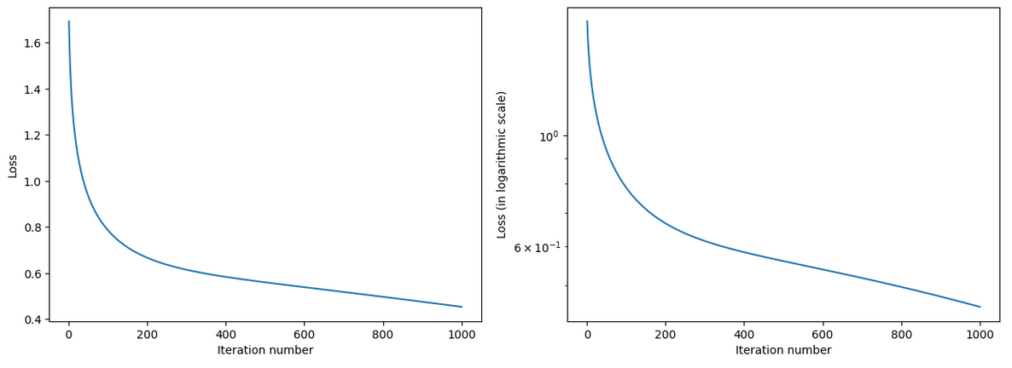
Good Practice #1: Using additional performance metrics beyond loss
Counter-example from Notebook 4:
We were able to train, if we consider the loss evolution curves…

Slide 7
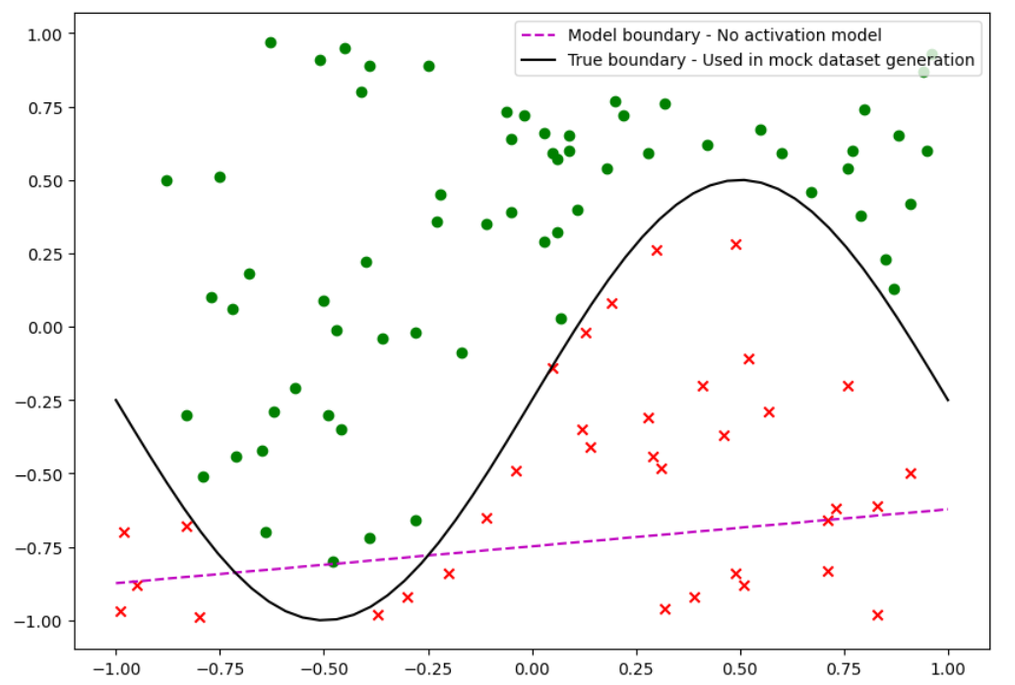
Good Practice #1: Using additional performance metrics beyond loss
Counter-example from Notebook 4:
If we consider the accuracy of the model, however…
Then it is fairly obvious that the model failed to produce the correct classification.

Slide 8
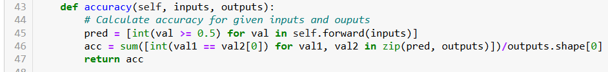
Good Practice #1: Using additional performance metrics beyond loss
As such, it would be a good idea to have some more interpretable performance metrics on the side, such as the accuracy for instance, to display along with the loss function during training.
This could confirm that the model succeeds at the task (or not).
1. Let us start by adding an accuracy method to our model.

Slide 9
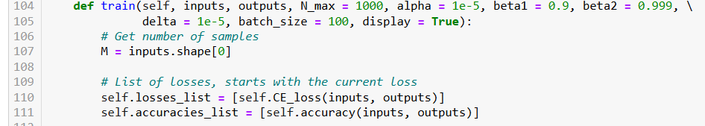
Good Practice #1: Using additional performance metrics beyond loss
As such, it would be a good idea to have some more interpretable performance metrics on the side, such as the accuracy for instance, to display along with the loss function during training.
This could confirm that the model succeeds at the task (or not).
2. We can then add another list for tracking accuracies, along with losses during training.

Slide 10
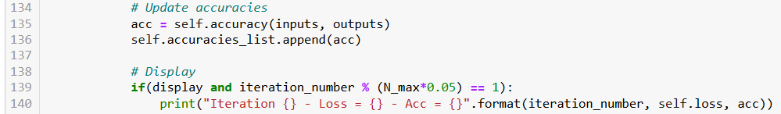
Good Practice #1: Using additional performance metrics beyond loss
As such, it would be a good idea to have some more interpretable performance metrics on the side, such as the accuracy for instance, to display along with the loss function during training.
This could confirm that the model succeeds at the task (or not).
3. During training we will update the accuracy of the model, appending to list, and displaying them during training along with loss.

Slide 11
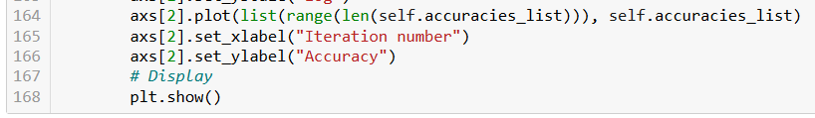
Good Practice #1: Using additional performance metrics beyond loss
As such, it would be a good idea to have some more interpretable performance metrics on the side, such as the accuracy for instance, to display along with the loss function during training.
This could confirm that the model succeeds at the task (or not).
4. Finally, amend our performance curves to show evolution of accuracy over the training iterations.

Slide 12
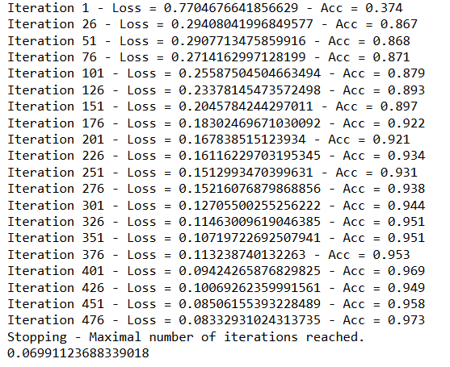
Good Practice #1: Using additional performance metrics beyond loss
When the model is trained, we can see the evolution of the accuracy performance metric.
This accuracy score is a more interpretable metric for humans.
Here, it shows that the model accuracy increases and approaches 100%, which is a (very) good sign.

Slide 13
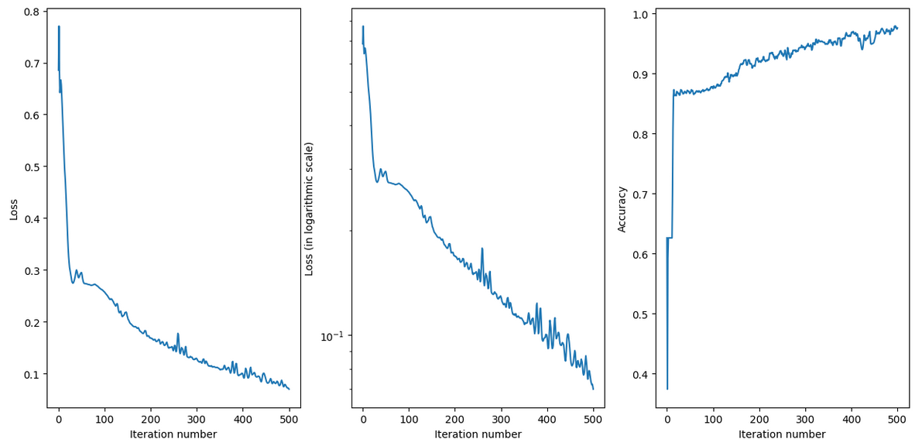
Good Practice #1: Using additional performance metrics beyond loss
And of course, additional metrics means additional training curves.

Slide 14
Good Practice #2: Using a train-test-valid split
Good practice #2: Using a train-test-validation split.
If you allow the model to train, you will most likely realize that the accuracy reaches 100% (or close to 100% after a few iterations).
The loss could, however, be minimized even further.
This raises a few questions:
- Should we have stopped when the accuracy was already 100%?
- Are we at risk of overfitting by pursuing the training to minimize the loss even more, even though it will not improve the accuracy further?

Slide 15
Good Practice #2: Using a train-test-valid split
While it is true that we are using the minimization of the loss function to train our model and decide on its parameters...
Our ultimate objective was NEVER to minimize the training loss function (or maximize the accuracy we obtain on training samples).
Our objective is and always has been generalization, that is training a model that will generalize well to unseen data.
This was the rationale for using a train-test split earlier.

Slide 16
Good Practice #2: Using a train-test-valid split
In Week 1, we introduced the concept of generalization and discussed how it is common practice not to evaluate the performance of the model on the same samples that have been used for training.
This led us to define two sets, called train and test sets, and we would:
Use the train samples in the backpropagation/training procedure,
And use the test samples to objectively evaluate the model and assess if it is able to generalize well or not.
We will push it one step further, by introducing the concept of train, test and validation samples.

Slide 17
Good Practice #2: Using a train-test-valid split
Good practice #2: Using a train-test-validation split.
During the data preparation procedure, we will now split the data in three sets:
Training samples
Validation samples
Test samples.
The training set is used to train the machine learning model.
The model is presented with many examples from the training set, and the model "learns" to make good predictions based on those examples.
For the training procedure to be efficient, most samples from the dataset should go into the training set.

Slide 18
Good Practice #2: Using a train-test-valid split
After each iteration of training, the model is tested on the validation set to assess the performance of the model and see how well it would generalize to unseen data.
We will use it to spot underfitting and overfitting in training.
The validation set requires less samples than the training set.
The validation set will also be used to choose the best hyperparameters for training the model (Good Practice #3-4).
The validation set will also be used to decide on the best model parameters to use after several training rounds (Good Practice #3-4).
For this reason, it can NOT be used to compute an objective performance metric to measure the generalization capabilities of our model.

Slide 19
Good Practice #2: Using a train-test-valid split
As before, the test set is a set of data that the model has NOT SEEN during the training or validation process.
It is used to evaluate the final performance of the model after training is complete, hence providing an estimate of how well the model will perform on truly unseen data (generalization!).
The testing set is usually set to have as many samples as the validation set.
Training Set (50.039) | Validation Set (50.039) | Test Set (after 50.039)
Supporting examples in notebooks shown for illustration and discussed in class. | Ungraded practice, guided homeworks, and exams allowing you to practice with concepts and self-assess. | Your future professional projects (after you graduate) on which you will have to use concepts taught in class, but these problems you have not seen yet. Objective of 50.039 = generalization capability of students?

Slide 20
Good Practice #2: Using a train-test-valid split
Question: What is considered a good repartition for the train-test-validation split?
The core idea is that:
We want as many samples as possible in the training set, as this helps training of the model.
We want enough samples in validation/test sets, to ensure diversity and that the law of large numbers applies.
Reminder from the past (Law of large numbers): When calculating a mean/average metric, like MSE, we need enough samples so that the empirical approximation matches closely the theoretical value.

Slide 21
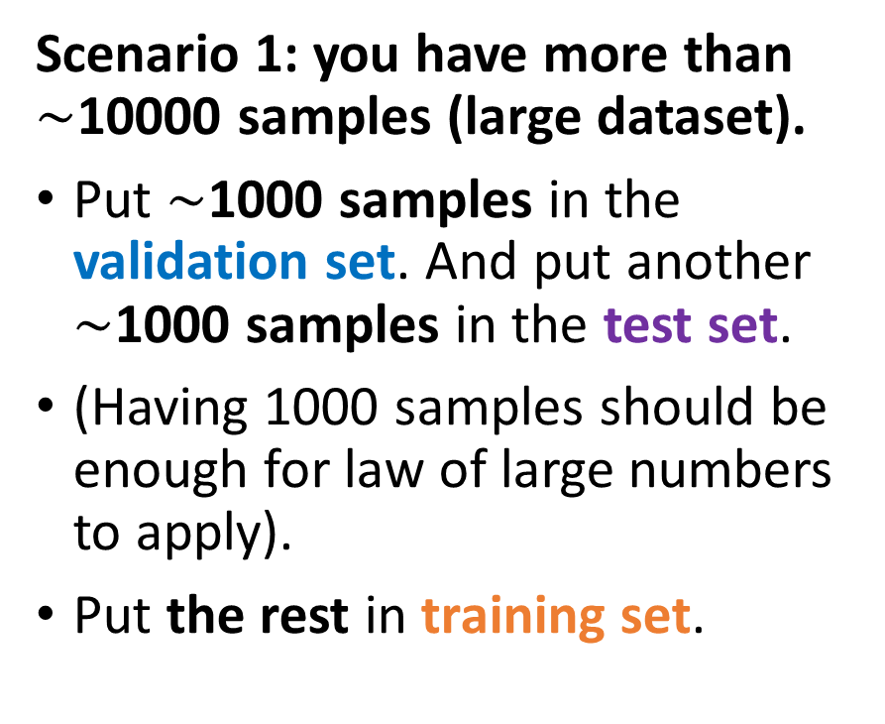
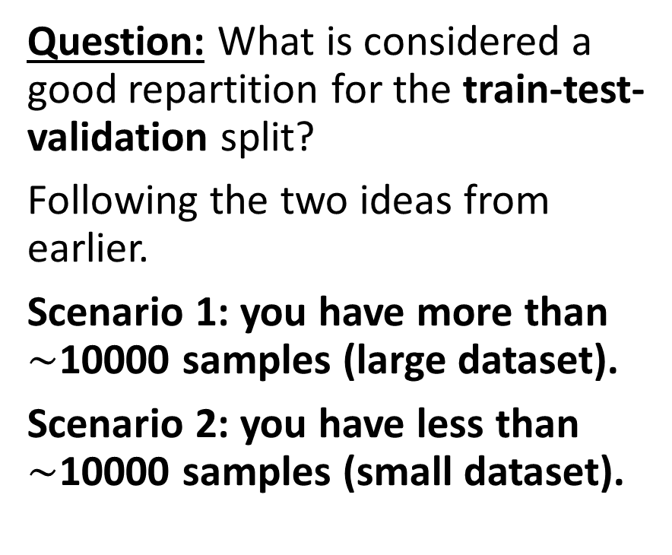
Good Practice #2: Using a train-test-valid split
Question: What is considered a good repartition for the train-test-validation split?
Following the two ideas from earlier.
Scenario 1: you have more than $\sim$10000 samples (large dataset).
Scenario 2: you have less than $\sim$10000 samples (small dataset).
Scenario 1: you have more than $\sim$10000 samples (large dataset).
Put $\sim$1000 samples in the validation set. And put another $\sim$1000 samples in the test set.
(Having 1000 samples should be enough for law of large numbers to apply).
Put the rest in training set.

Slide 22
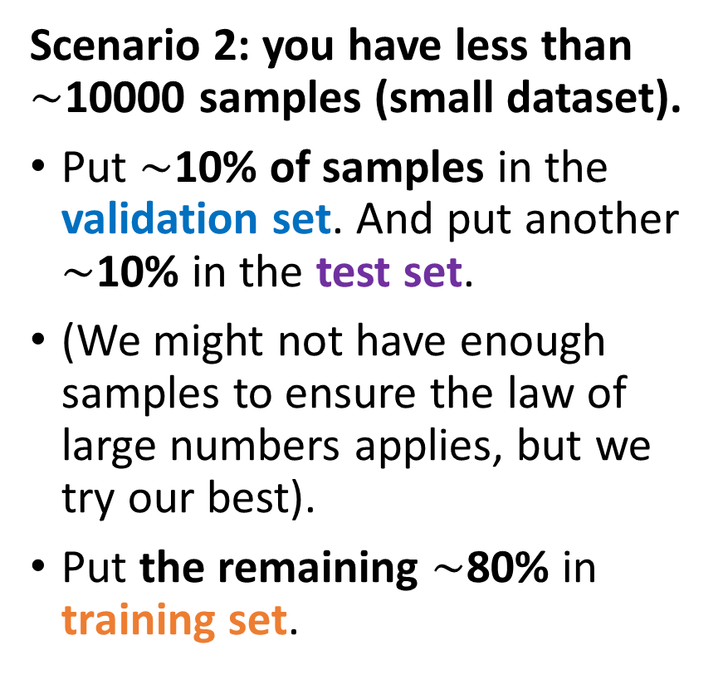
Good Practice #2: Using a train-test-valid split
Question: What is considered a good repartition for the train-test-validation split?
Following the two ideas from earlier.
Scenario 1: you have more than $\sim$10000 samples (large dataset).
Scenario 2: you have less than $\sim$10000 samples (small dataset).
Scenario 2: you have less than $\sim$10000 samples (small dataset).
Put $\sim$10% of samples in the validation set. And put another $\sim$10% in the test set.
(We might not have enough samples to ensure the law of large numbers applies, but we try our best).
Put the remaining $\sim$80% in training set.

Slide 23
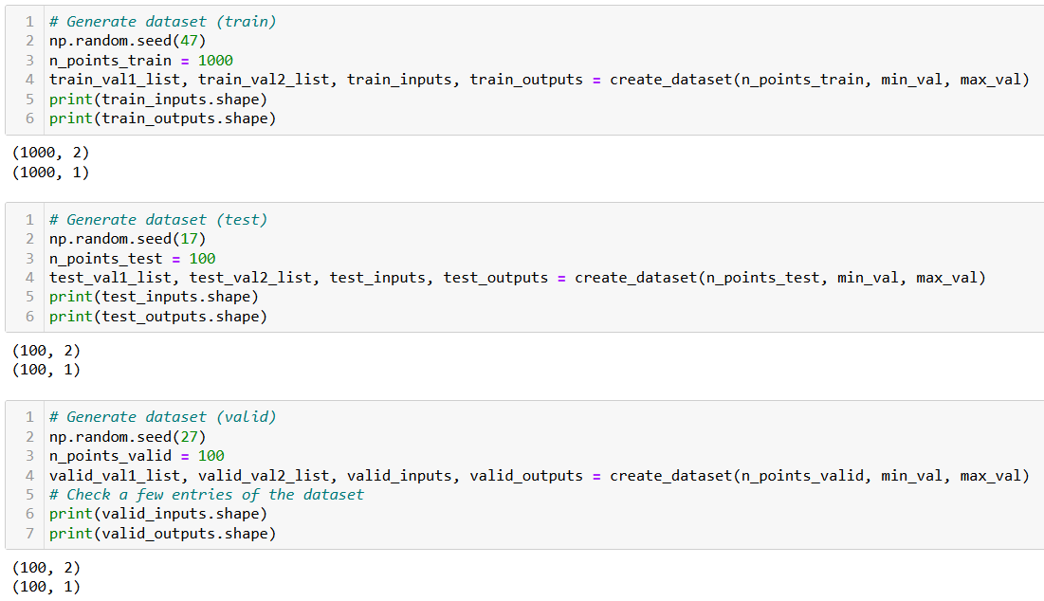
Good Practice #2: Using a train-test-valid split
Here, we will “mimic” a splitting by using our dataset generator three times, with different seeds and number of samples each time.

Slide 24
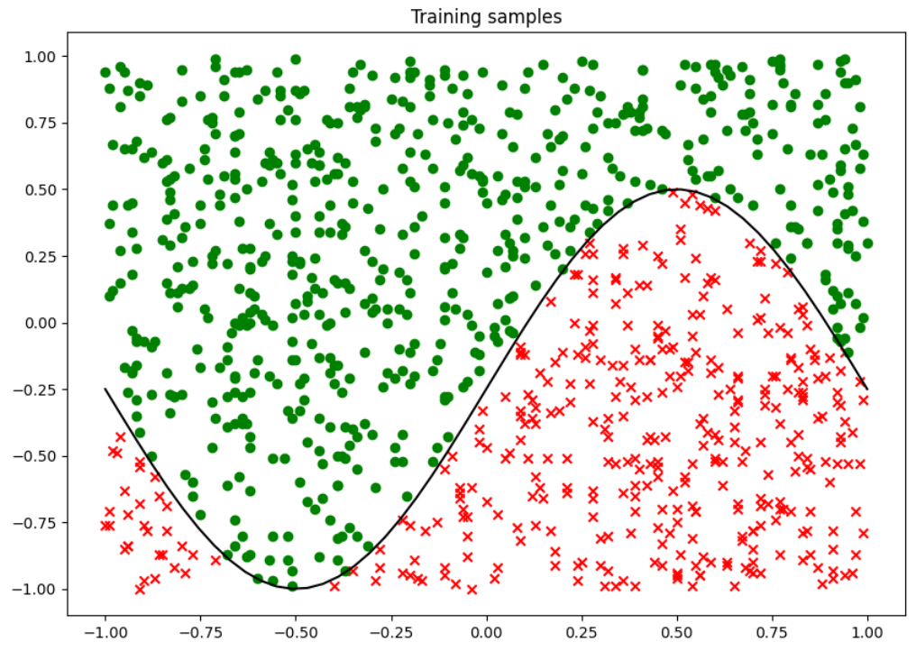
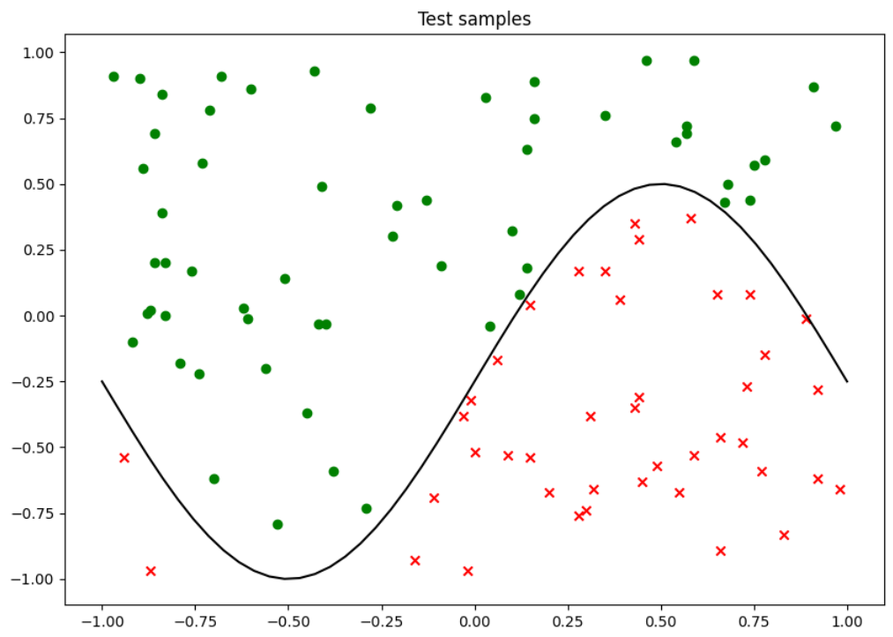
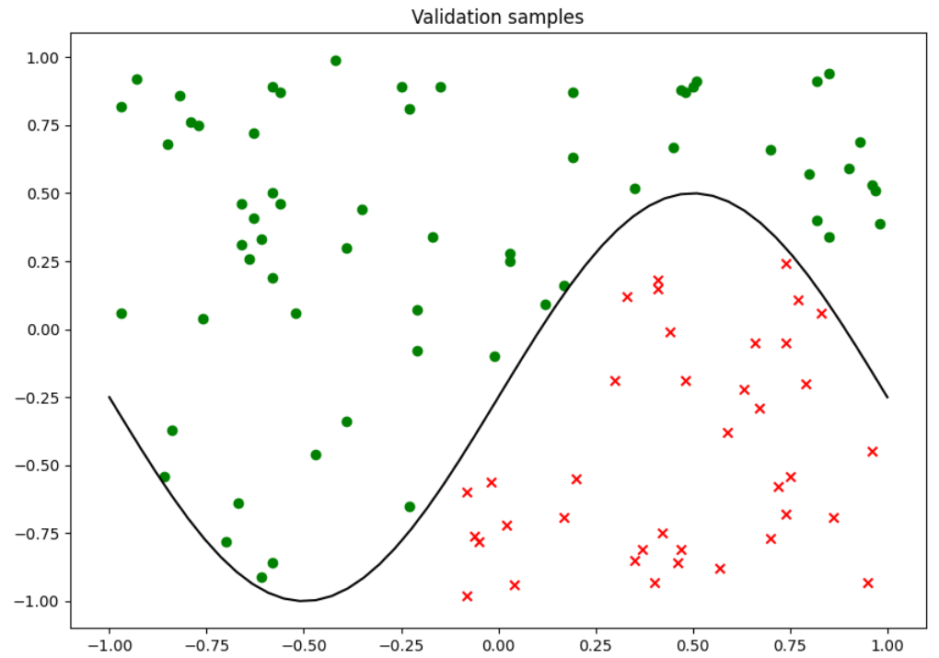
Good Practice #2: Using a train-test-valid split

Slide 25
Good Practice #2: Using a train-test-valid split
During training pass all three datasets as parameters

Slide 26
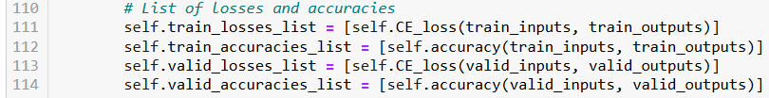
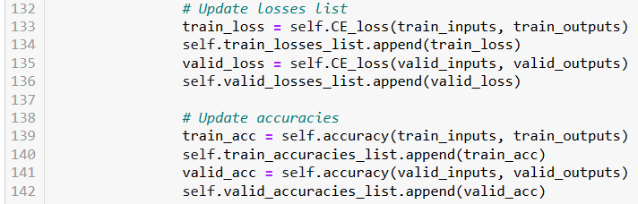
Good Practice #2: Using a train-test-valid split
A few more changes…
1. Track losses and accuracies during training on both training and validation sets.

Slide 27
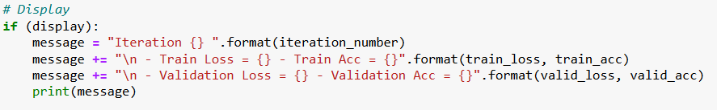
Good Practice #2: Using a train-test-valid split
A few more changes…
2. On each iteration, display losses and accuracies on both the training and validation sets.

Slide 28
Good Practice #2: Using a train-test-valid split
A few more changes…
3. After training has completed, check accuracy values (and, optionally, loss values) on the test set for a final confirmation, on the model’s generalization capabilities.

Slide 29
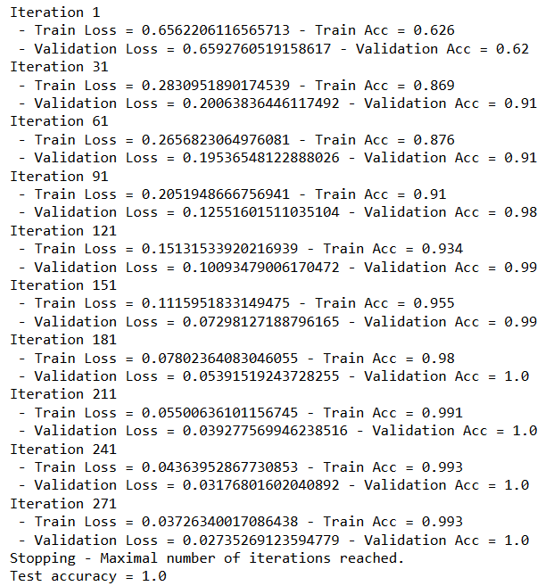
Good Practice #2: Using a train-test-valid split
Training the model now gives the following full display.
In general, three possibilities:
Poor values on both train metrics and validation metrics → Underfitting.
Good values on train metrics, poor values on validation metrics → Overfitting.
Good values on both train and validation metrics → Great!

Slide 30
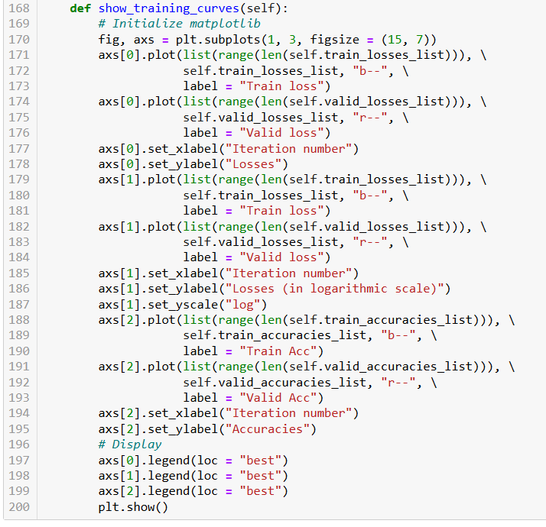
Good Practice #2: Using a train-test-valid split
A few more changes…
4. Training curves will now include training and validation values.

Slide 31
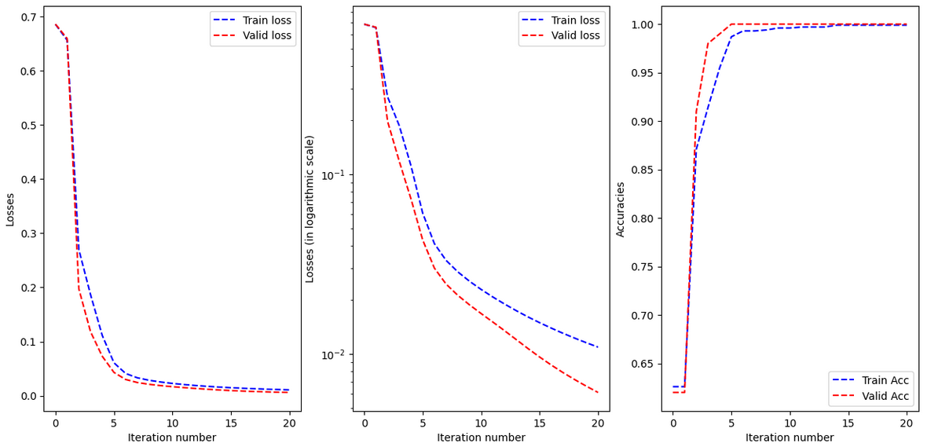
Good Practice #2: Using a train-test-valid split
Training our model gives following training curves (Good training).

Slide 32
Good Practice #2: Using a train-test-valid split
Note: A model that can generalize well will often have close curves on both training and validation sets. And a good final test accuracy value.

Slide 33
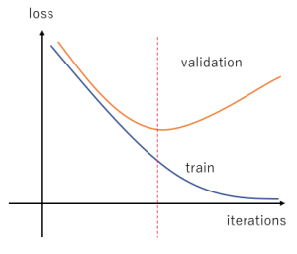
Good Practice #2: Using a train-test-valid split
In general,
Model will start by underfitting the data, which is normal.
After a few rounds of training models will train and (hopefully) achieve good generalization.
Then, if training is pursued, the model will often attempt to minimize loss at all costs, often sacrificing generalization (!) in the process, and overfitting.
Training should probably have stopped at this point (in red).

Slide 34
Good Practice #3: Implementing an early stop
Good Practice #3: Implementing an early stop.
It is often a good idea to try and stop the training when the model starts losing its generalization capabilities and starts overfitting.
We often want to stop when:
Validation metrics achieve the best results (lowest loss or highest accuracy).
Validation and training curves start going in opposite ways.
Training should probably have stopped at this point (in red).

Slide 35
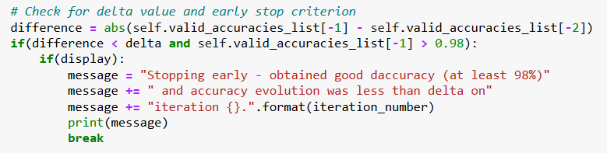
Good Practice #3: Implementing an early stop
Some approaches suggest to simply track a validation metric (e.g. accuracy) and define an early stopping, which interrupts training when:
A high level of accuracy has been obtained (say, at least 98%),
And the accuracy is no longer increasing (i.e. the change between two consecutive values of the accuracy is falling below a threshold).

Slide 36
Good Practice #3: Implementing an early stop
Some approaches suggest to simply track a validation metric (e.g. accuracy) and define an early stopping, which interrupts training when:
A high level of accuracy has been obtained (say, at least 98%),
And the accuracy is no longer increasing (i.e. the change between two consecutive values of the accuracy is falling below a threshold).
Nice, but…

Slide 37
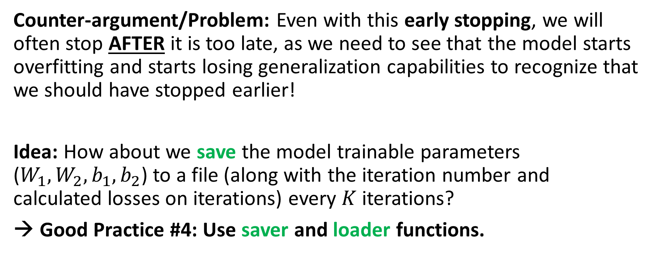
Good Practice #4: Saver and loader functions
Counter-argument/Problem: Even with this early stopping, we will often stop AFTER it is too late, as we need to see that the model starts overfitting and starts losing generalization capabilities to recognize that we should have stopped earlier!
Idea: How about we save the model trainable parameters ($W_{1}, W_{2}, b_{1}, b_{2}$) to a file (along with the iteration number and calculated losses on iterations) every $K$ iterations?
→ Good Practice #4: Use saver and loader functions.

Slide 38
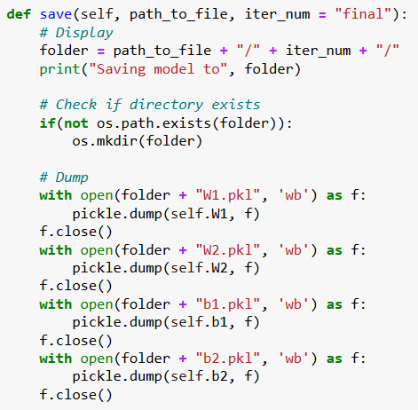
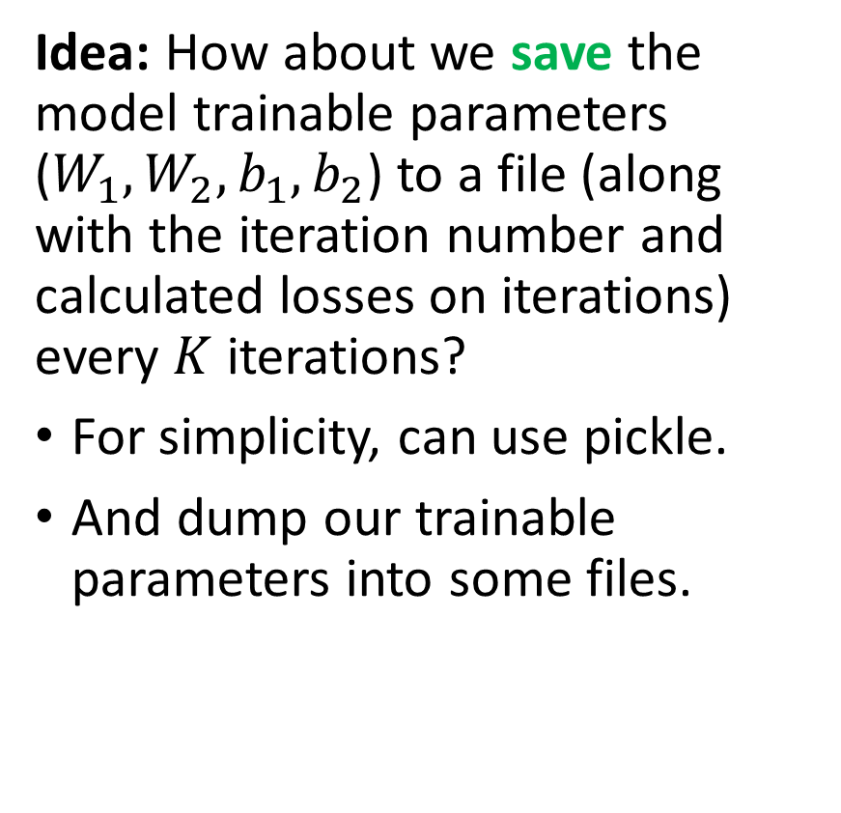
Good Practice #4: Saver and loader functions
Idea: How about we save the model trainable parameters ($W_{1}, W_{2}, b_{1}, b_{2}$) to a file (along with the iteration number and calculated losses on iterations) every $K$ iterations?
For simplicity, can use pickle.
And dump our trainable parameters into some files.

Slide 39
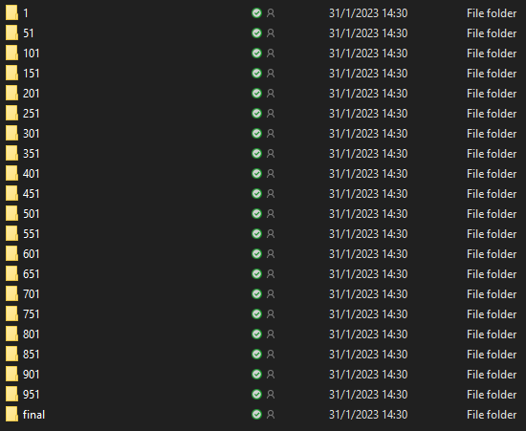
Good Practice #4: Saver and loader functions
Idea: How about we save the model trainable parameters ($W_{1}, W_{2}, b_{1}, b_{2}$) to a file (along with the iteration number and calculated losses on iterations) every $K$ iterations?
For simplicity, can use pickle.
And dump our trainable parameters into some files.

Slide 40
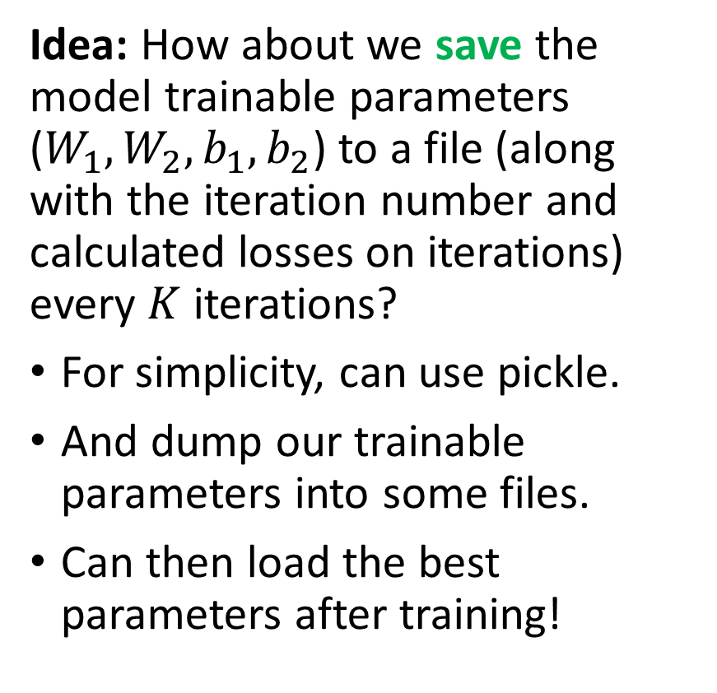
Good Practice #4: Saver and loader functions
Training should probably have stopped at this point (in red).
Idea: How about we save the model trainable parameters ($W_{1}, W_{2}, b_{1}, b_{2}$) to a file (along with the iteration number and calculated losses on iterations) every $K$ iterations?
For simplicity, can use pickle.
And dump our trainable parameters into some files.
Can then load the best parameters after training!
Trained for too long? No big deal, backtrack and load the weights corresponding to the best iteration!

Slide 41
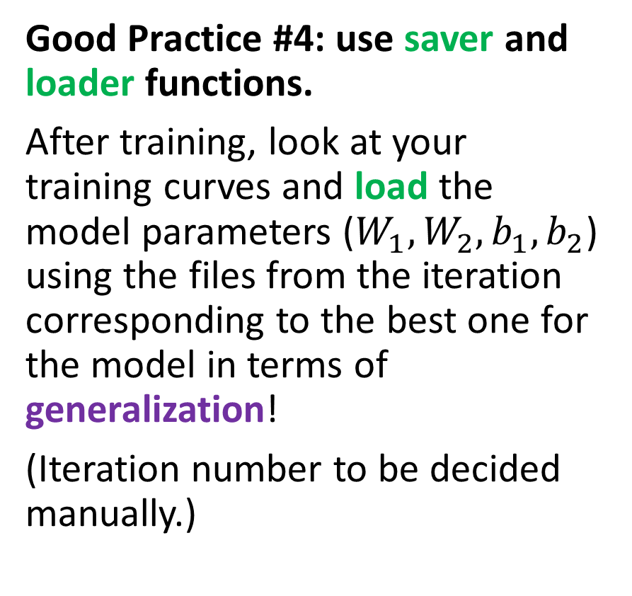
Good Practice #4: Saver and loader functions
Training should probably have stopped at this point (in red).
Good Practice #4: use saver and loader functions.
After training, look at your training curves and load the model parameters ($W_{1}, W_{2}, b_{1}, b_{2}$) using the files from the iteration corresponding to the best one for the model in terms of generalization!
(Iteration number to be decided manually.)
Trained for too long? No big deal, backtrack and load the weights corresponding to the best iteration!

Slide 42
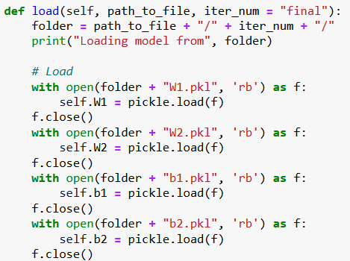
Good Practice #4: Saver and loader functions
Good Practice #4: use saver and loader functions.
After training, look at your training curves and load the model parameters ($W_{1}, W_{2}, b_{1}, b_{2}$) using the files from the iteration corresponding to the best one for the model in terms of generalization!
(Iteration number to be decided manually.)

Slide 43
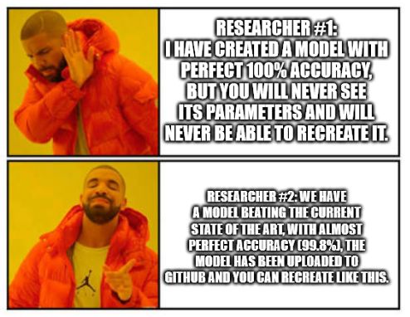
Saver/loader functions are critical in AI
Reproducibility: After training, it is important that you give your client a simple way to load your trained model. You would not want the client to re-run the training (especially if it takes a VERY long time to train!)
It is also important if you do AI research, as your research will have little to no credibility if you are not able to let other people see the final model at work.

Slide 44

Saver/loader functions are critical
Preventing data loss: Training a heavy model can take a long time, sometimes even days or weeks, if the model architecture is massive.
If the training process is interrupted, all the progress made so far will be lost, unless the model has been saved.
In case of an interruption, we can simply load the latest save of the model, and resume the training, instead of restarting from scratch.

Slide 45
Typical questions about model architecture
Typical questions asked by students regarding the size of a neural network model.
How many layers does my model need?
How many neurons should I put in each layer?
Is it better to have more layers or more neurons per layer?
The answer to these questions will surprise you.

Slide 46

Typical questions about model architecture
Typical questions asked by students regarding the size of a neural network model.
How many layers does my model need?
How many neurons should I put in each layer?
Is it better to have more layers or more neurons per layer?
The answer to these questions will surprise you.

Slide 47
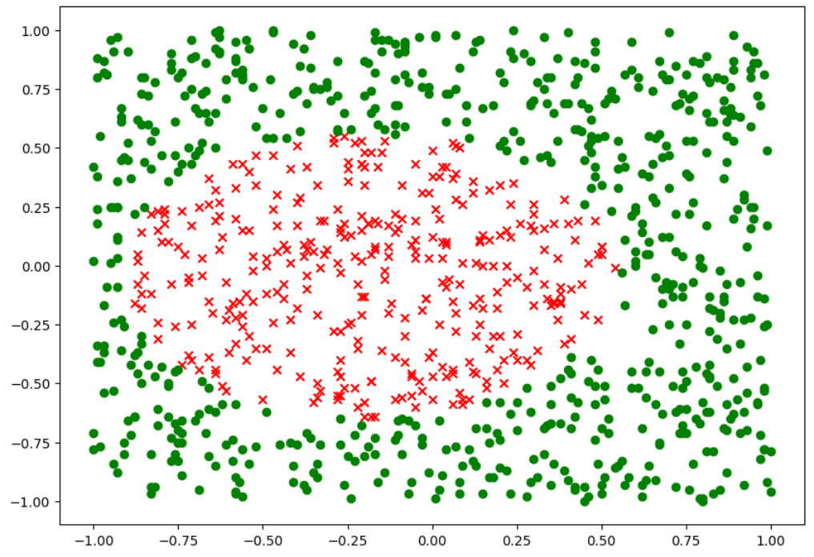
Problem statement
Consider the following binary classification dataset.
It follows the same logic as our previous dataset, but the boundary seems to have a different shape, and its equation is not given this time.
It looks nicely separable, so we should be able to train a classifier model with near-perfect accuracy.

Slide 48
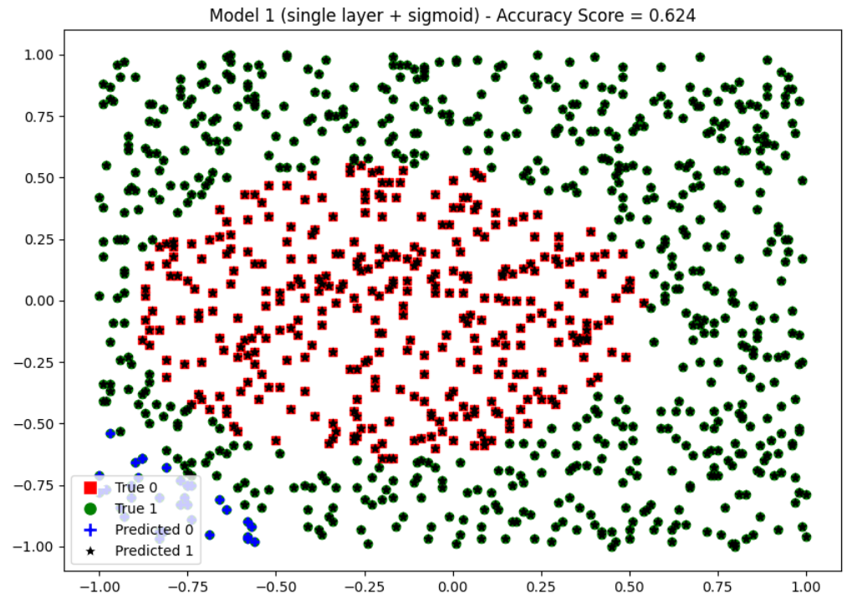
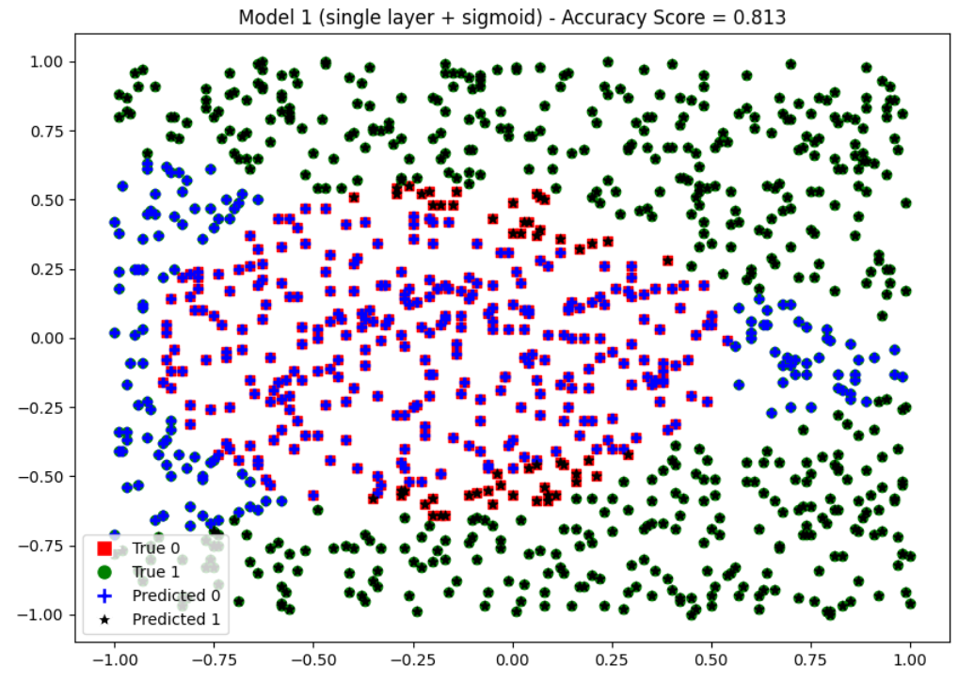
Problem statement
In Notebook 8 we will first try train two models:
Model 1: 1-layer neural network, 62% accuracy (on top)
Model 2: 2-layers neural network, 81% accuracy (bottom).
Unfortunately, it seems both models are struggling to learn…
Question: What could we do then?

Slide 49
Problem statement
Three suggested approaches/tasks for you to try in this Notebook 8:
Adding a second layer helped, let us try adding a third layer? (We will need to rework most methods in our Neural Network class, as it only includes two layers at the moment).
How about we stick to two layers only and use more neurons in the first layer of the neural network?
How about a bit of feature engineering? (That is reworking our dataset a bit to produce more useful features that could help our neural networks)
Guided Practice, solutions are provided (but no cheating!)

Slide 50
Well, let us experiment then?
Have a look at Notebook 8, it comes with three practice tasks. (Solutions are also available in the solutions folder).
No homework again this week, so playing with this notebook is your homework!

Slide 51
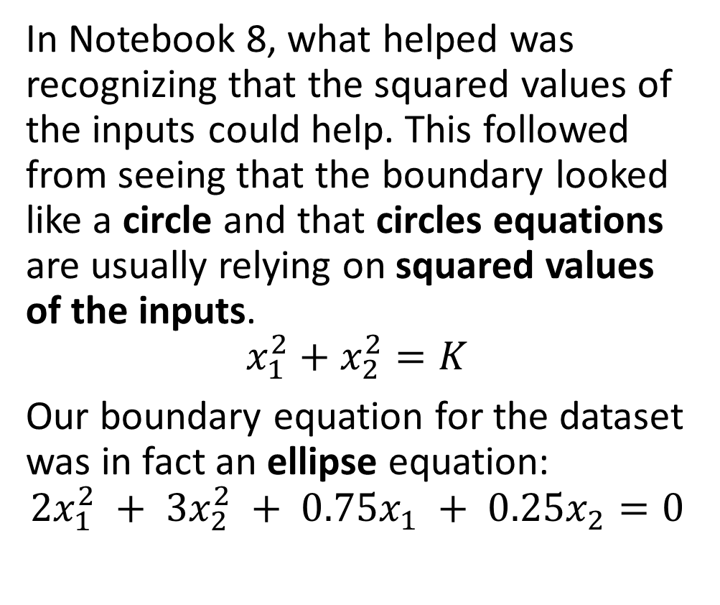
Lesson #1: Features engineering is king!
In general, feature engineering is the direction which offers the largest improvement potential for our models.
If you have a hunch about which features could help the network classify better, you should attempt some feature engineering.
Problem: it requires a strong mathematical intuition/domain expertise about the dataset!
In Notebook 8, what helped was recognizing that the squared values of the inputs could help. This followed from seeing that the boundary looked like a circle and that circles equations are usually relying on squared values of the inputs.
$$x_{1}^{2}+x_{2}^{2}=K$$ Our boundary equation for the dataset was in fact an ellipse equation:
$$2x_{1}^{2} + 3x_{2}^{2} + 0.75x_{1} + 0.25x_{2}=0$$

Slide 52
Lesson #2: Larger layers vs. More layers
The number of layers to use in a neural network can vary depending on the complexity of the task and the size of the data. It is a hyperparameter that can be tuned through experimentation.
In general, deeper networks (more layers) can learn more complex representations, but they are also more computationally expensive and prone to overfitting.
On the other hand, shallower networks are less expensive and less prone to overfitting, but they may not have enough capacity to learn the task.

Slide 53
Lesson #2: Larger layers vs. More layers
As far as I know, there is no rule of thumb formula for determining the number of layers to use based on the shape of a dataset.
The number of layers in a neural network model is determined by a variety of factors, including the complexity of the problem, the size of the input data, and the available computational resources.
If the data is linearly separable then you do not need any hidden layers or activation functions, just use a linear regression!
If data is low-complexity and has few dimensions/features, then 2 layers would often work, or are a good starting point.
If data is high-complexity or has many dimensions/features, then using more hidden layers is required (ideal number to be tested).

Slide 54
Lesson #2: Larger layers vs. More layers
However, “adding an extra layer to a model that is failing and already has many layers in the hopes that it will suddenly fix it” is often foolish and will have limited results.
You need enough layers to match the complexity of the task, anything beyond that is most likely overkill and will not help.
More often than not, you are NOT using the right TYPE of layers that fits the TYPE of data you are playing with (more on this later).

Slide 55
Lesson #2: Larger layers vs. More layers
However, “adding an extra layer to a model that is failing and already has many layers in the hopes that it will suddenly fix it” is often foolish and will have limited results.
You need enough layers to match the complexity of the task, anything beyond that is most likely overkill and will not help.
More often than not, you are NOT using the right TYPE of layers that fits the TYPE of data you are playing with (more on this later).
In fact, adding more layers will likely lead to more overfitting!

Slide 56
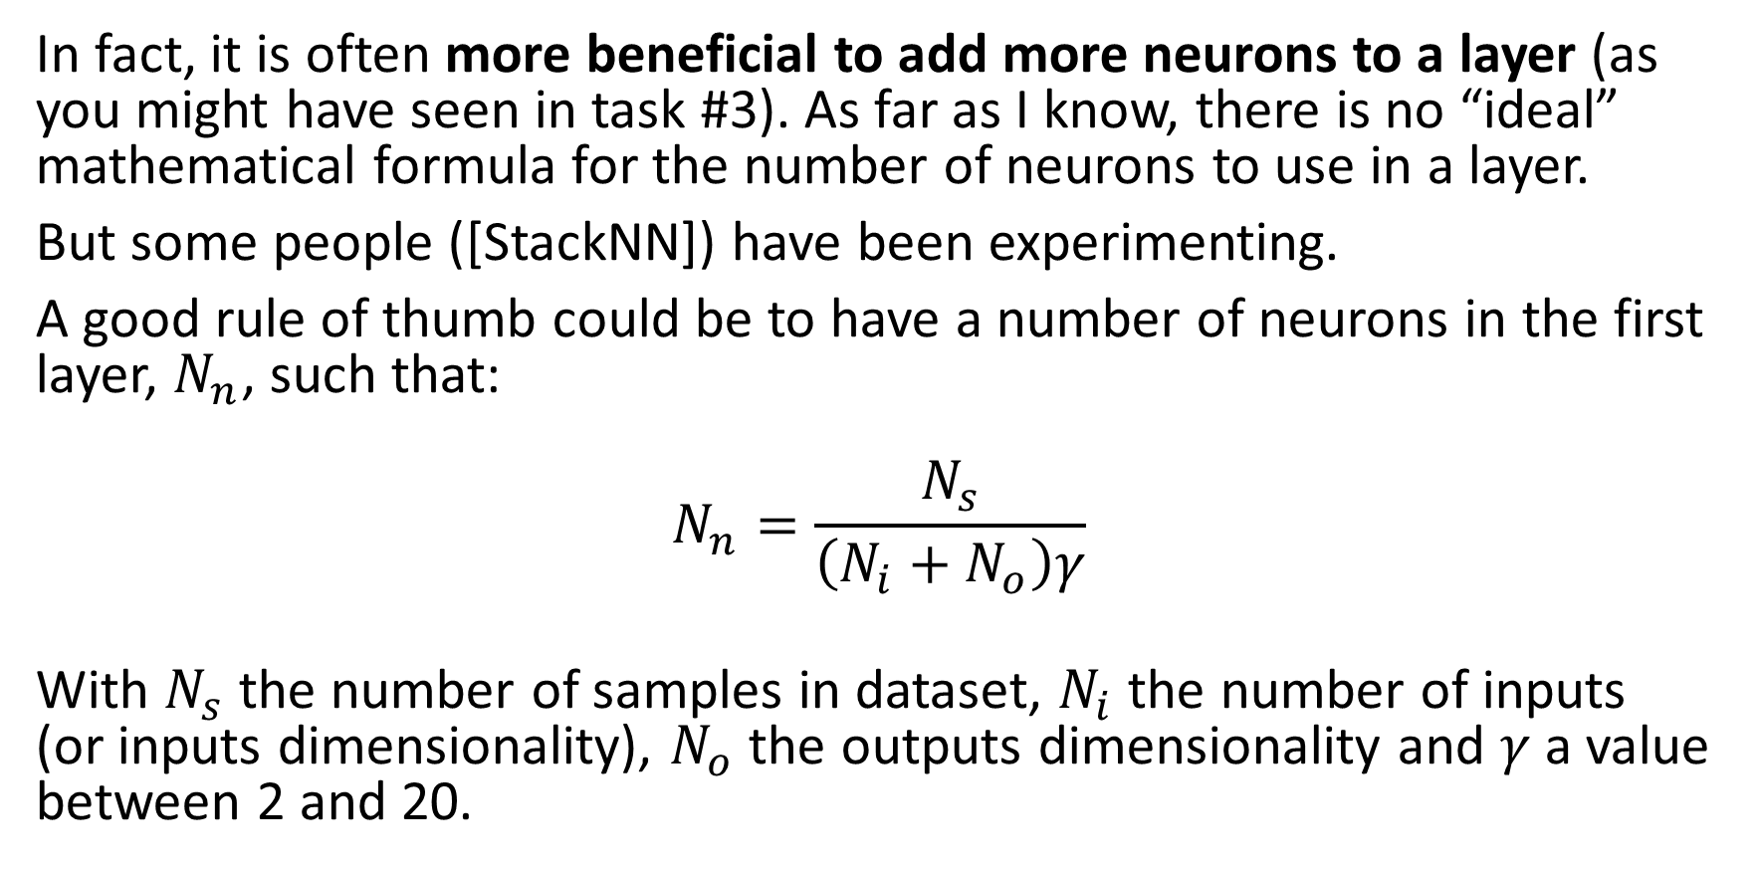
Lesson #2: Larger layers vs. More layers
In fact, it is often more beneficial to add more neurons to a layer (as you might have seen in task #3). As far as I know, there is no “ideal” mathematical formula for the number of neurons to use in a layer.
But some people ([StackNN]) have been experimenting.
A good rule of thumb could be to have a number of neurons in the first layer, $N_{n}$, such that:
$$N_{n}=\frac{N_{s}}{\left(N_{i}+N_{o}\right)γ}$$
With $N_{s}$ the number of samples in dataset, $N_{i}$ the number of inputs (or inputs dimensionality), $N_{o}$ the outputs dimensionality and $γ$ a value between 2 and 20.

Slide 57
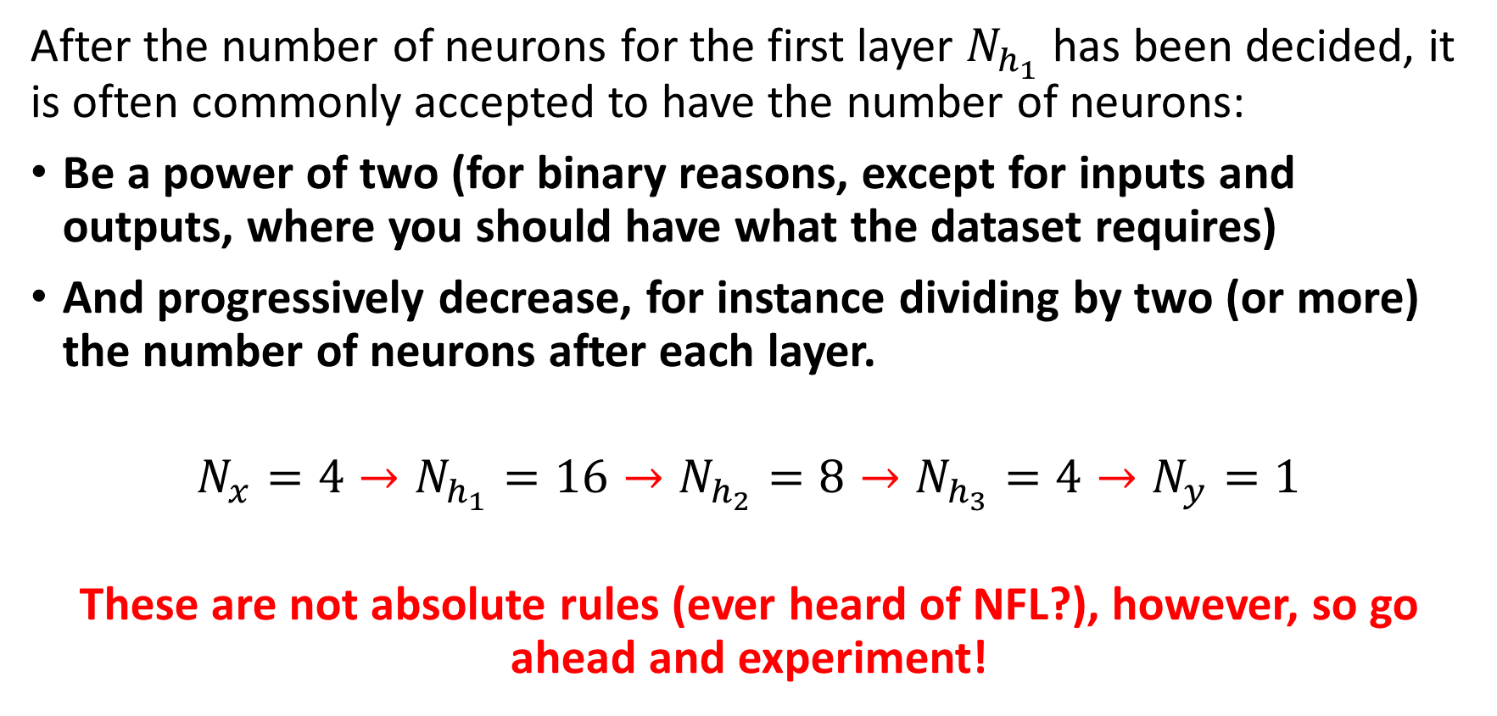
Lesson #2: Larger layers vs. More layers
After the number of neurons for the first layer $N_{h_{1}}$ has been decided, it is often commonly accepted to have the number of neurons:
Be a power of two (for binary reasons, except for inputs and outputs, where you should have what the dataset requires)
And progressively decrease, for instance dividing by two (or more) the number of neurons after each layer.
$$N_{x}=4→N_{h_{1}}=16→N_{h_{2}}=8→N_{h_{3}}=4→N_{y}=1$$
These are not absolute rules (ever heard of NFL?), however, so go ahead and experiment!

Slide 58
A friendly reminder, though, in case you still do not get it

Slide 59
Conclusion (Week 2)
The no free lunch theorem, again
Train-test-validation split
Early stopping
Saver and loader functions
A few more commonly accepted good practices
Next week?
Introduction to PyTorch framework and tensors
Implementing shallow Neural Networks in PyTorch
The power of AutoGrad and CUDA processing
Optimizers, initializers in PyTorch
Datasets and dataloaders
From shallow to deep NNs

Slide 60
Hyperparameters tuning and searching
Definition (hyperparameters tuning and searching):
Earlier, we have identified that several parameters in our neural networks had to be manually decided by the user and called those hyperparameters.
Unfortunately, the NFL theorem tells us there is often no closed-form formula to tell you what is the best value to use for those hyperparameters.
Typical hyperparameters include:
Number of layers and their sizes,
Initializers to use for parameters,
Activation functions to use,
Learning rate, momentum and other parameters related to optimizers,
Etc.
No choice: try different values and possibilities. How to search?

Slide 61
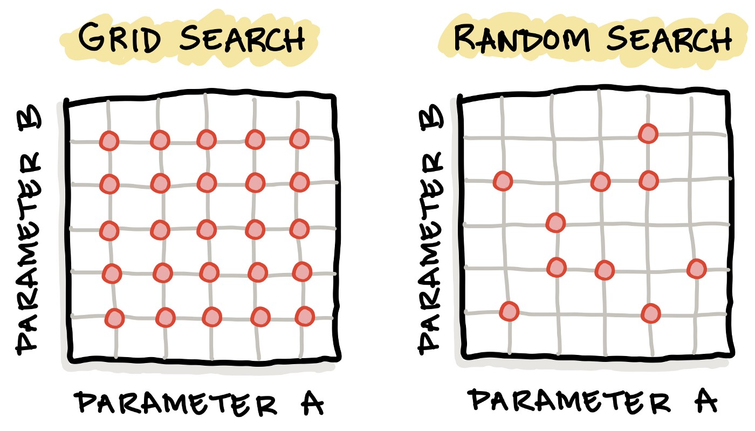
Hyperparameters tuning and searching
Definition (hyperparameter grid searching):
Grid search is the simplest algorithm for hyperparameter tuning.
Basically, we divide the domain of possible values for each of the hyperparameters into a discrete grid. Then, we will try every combination of values of this grid, calculating some performance metrics.

Slide 62
Hyperparameters tuning and searching
Definition (hyperparameter random searching):
Random search is another algorithm for hyperparameter tuning.
Random search defines a search space as a bounded domain of hyperparameter values and randomly sample points in that domain. After trying enough values, keep the best hyperparameters configuration.

Slide 63
Hyperparameters tuning and searching
In general (see [HypSearch]),
Grid search is often better on small spaces,
Whereas random search is better on large domains but has no guarantee of returning a good configuration.
More advanced techniques beyond these two exist, such as Bayesian Optimization, Evolutionary Optimization, etc.

Slide 64
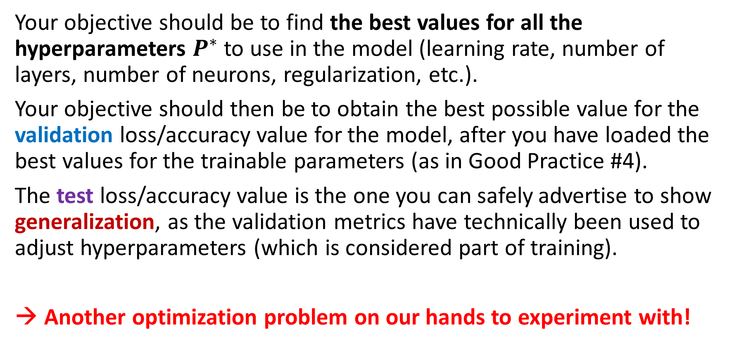
Hyperparameters tuning and searching
Your objective should be to find the best values for all the hyperparameters $P^{∗}$ to use in the model (learning rate, number of layers, number of neurons, regularization, etc.).
Your objective should then be to obtain the best possible value for the validation loss/accuracy value for the model, after you have loaded the best values for the trainable parameters (as in Good Practice #4).
The test loss/accuracy value is the one you can safely advertise to show generalization, as the validation metrics have technically been used to adjust hyperparameters (which is considered part of training).
→ Another optimization problem on our hands to experiment with!

Slide 65
Learn more about these topics
Some extra (easy) reading and videos for those of you who are curious.
[HypSearch] How to run hyperparameters searching in Python, implementations using Scikit learn and more advanced methods. https://towardsdatascience.com/7-hyperparameter-optimization-techniques-every-data-scientist-should-know-12cdebe713da And https://machinelearningmastery.com/hyperparameter-optimization-with-random-search-and-grid-search/
[StackNN] How to decide on a number of neurons and layers in Neural Networks? https://stats.stackexchange.com/questions/181/how-to-choose-the-number-of-hidden-layers-and-nodes-in-a-feedforward-neural-netw

